Slide 1
AWS Lambda
Amazon Web Services

Slide 2


What is Lambda
AWS Lambda is a serverless compute solution. It enables you to run code without having to provision or manage underlying compute infrastructure such as EC2 Instances. You can simply write and upload your code as a .zip file or a container image and configure necessary triggers for your function to run.
Lambda functions will run only when triggered
Write your lambda function in a supported high level programming language
Lambda function
Trigger
Trigger Lambda from over 200 AWS services and software as a service (SaaS) applications
Lambda will run your function in isolated environment, managed by AWS

Slide 3
What is Lambda
AWS Lambda is a serverless compute solution. It enables you to run code without having to provision or manage underlying compute infrastructure such as EC2 Instances. You can simply write and upload your code as a .zip file or a container image and configure necessary triggers for your function to run.
Lambda functions will run only when triggered
Write your lambda function in a supported high level programming language
Lambda function
Trigger

Slide 4
What is Lambda
AWS Lambda is a serverless compute solution. It enables you to run code without having to provision or manage underlying compute infrastructure such as EC2 Instances. You can simply write and upload your code as a .zip file or a container image and configure necessary triggers for your function to run.
Lambda functions will run only when triggered
Write your lambda function in a supported high level programming language
Lambda function
Trigger
AWS Lambda will scale your function to meet demand

Slide 5
Who manages what?
AWS’s responsibility
AWS automatically manages the underlying compute resources for you and maintains a fault-tolerant infrastructure
AWS will scale the necessary compute resources to support the rate of incoming requests without any manual intervention
AWS will offer high availability for both the service itself and the functions it operates, running across multiple AZs in each AWS Region
Customer’s responsibility
You are still responsible for your code to run securely and effectively.
You can configure necessary IAM roles to allow your function to interact with other AWS services

Slide 6


Lambda Use Case
Use Amazon Simple Storage Service (Amazon S3) to trigger AWS Lambda data processing in real time after an upload.
Upload event triggers Lamba function
Image taken
Image uploaded to Amazon S3 bucket
Lambda runs image resize code
Image resized into mobile, tablet and web sizes

Slide 7
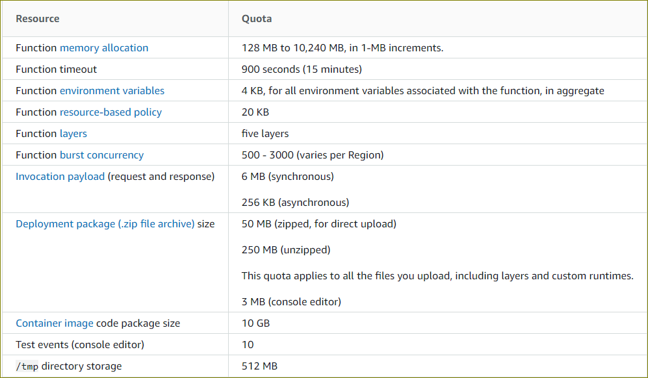
Lambda Limitations
Not all use cases are ideal for Lambda
Not ideal for:
Long running batch jobs
Deep learning processing
Not ideal for hosting content delivery systems like WordPress or Drupal
Ideal for quick processing and handling backend requests
https://docs.aws.amazon.com/lambda/latest/dg/gettingstarted-limits.html

Slide 8
Lambda pricing
You are only charged when Lambda executes your code
Lambda counts a request each time it starts executing in response to an event notification trigger
Duration is calculated from the time your code begins executing until it returns or otherwise terminates, rounded up to the nearest 1 ms*
Depends on the amount of memory you allocate to your function
As part of Free Tier, you get up to 1 million requests free per month
* Duration charges apply to code that runs in the handler of a function as well as initialization code that is declared outside of the handler

Slide 9
Next Video
Demo – AWS Lambda

